Slide 1



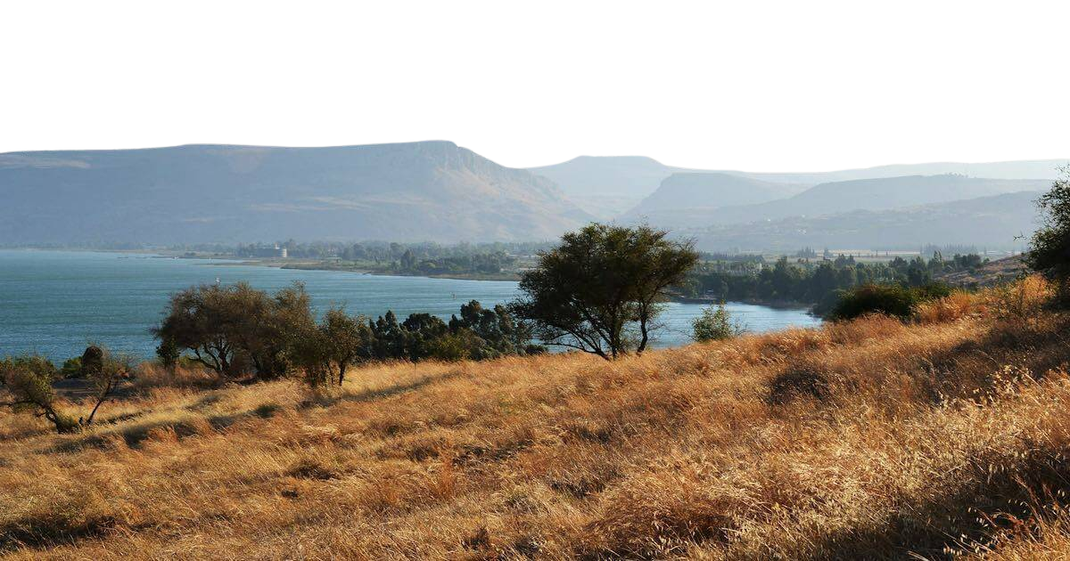

The Good Life:
Matthew 6:25-34

Slide 2
The Structure of the Sermon on the Mount
INTRODUCTION
5:1-16
MAIN SECTION
5:17-7:12
CONCLUSION
7:12-29
What kind of people are in God’s Kingdom
(Encouragements from Jesus)
What kind of righteousness (right living)
is in God’s Kingdom
What kind of people are in God’s Kingdom
(Warnings from Jesus)

Slide 3

What kind of righteousness (right living) is in God’s Kingdom
5:17-7:12
5:17-48
Our Obedience
From the heart
OUR RELATIONSHIP
WITH THE LAW

Slide 4

What kind of righteousness (right living) is in God’s Kingdom
5:17-7:12
5:17-48
Our Obedience
From the heart
6:1-24
Our Devotion
For our Heavenly Father
OUR RELATIONSHIP
WITH THE LAW
OUR RELATIONSHIP
WITH OUR HEAVENLY FATHER

Slide 5

What kind of righteousness (right living) is in God’s Kingdom
5:17-7:12
5:17-48
Our Obedience
From the heart
6:1-24
Our Devotion
For our Heavenly Father
6:25-7:12
Our Trust
In our Heavenly Father
OUR RELATIONSHIP
WITH THE LAW
OUR RELATIONSHIP
WITH OUR HEAVENLY FATHER

Slide 6


Slide 7


Slide 8
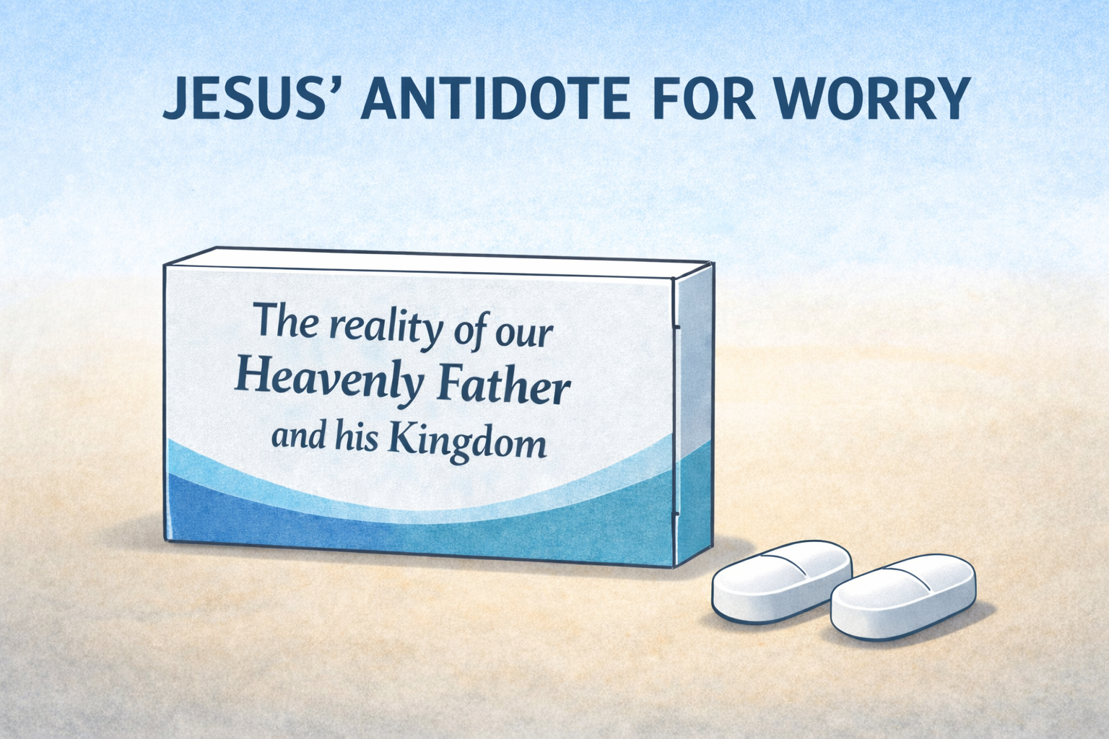

Slide 9

1) WHO IS YOUR PROVIDER IN LIFE

Slide 10
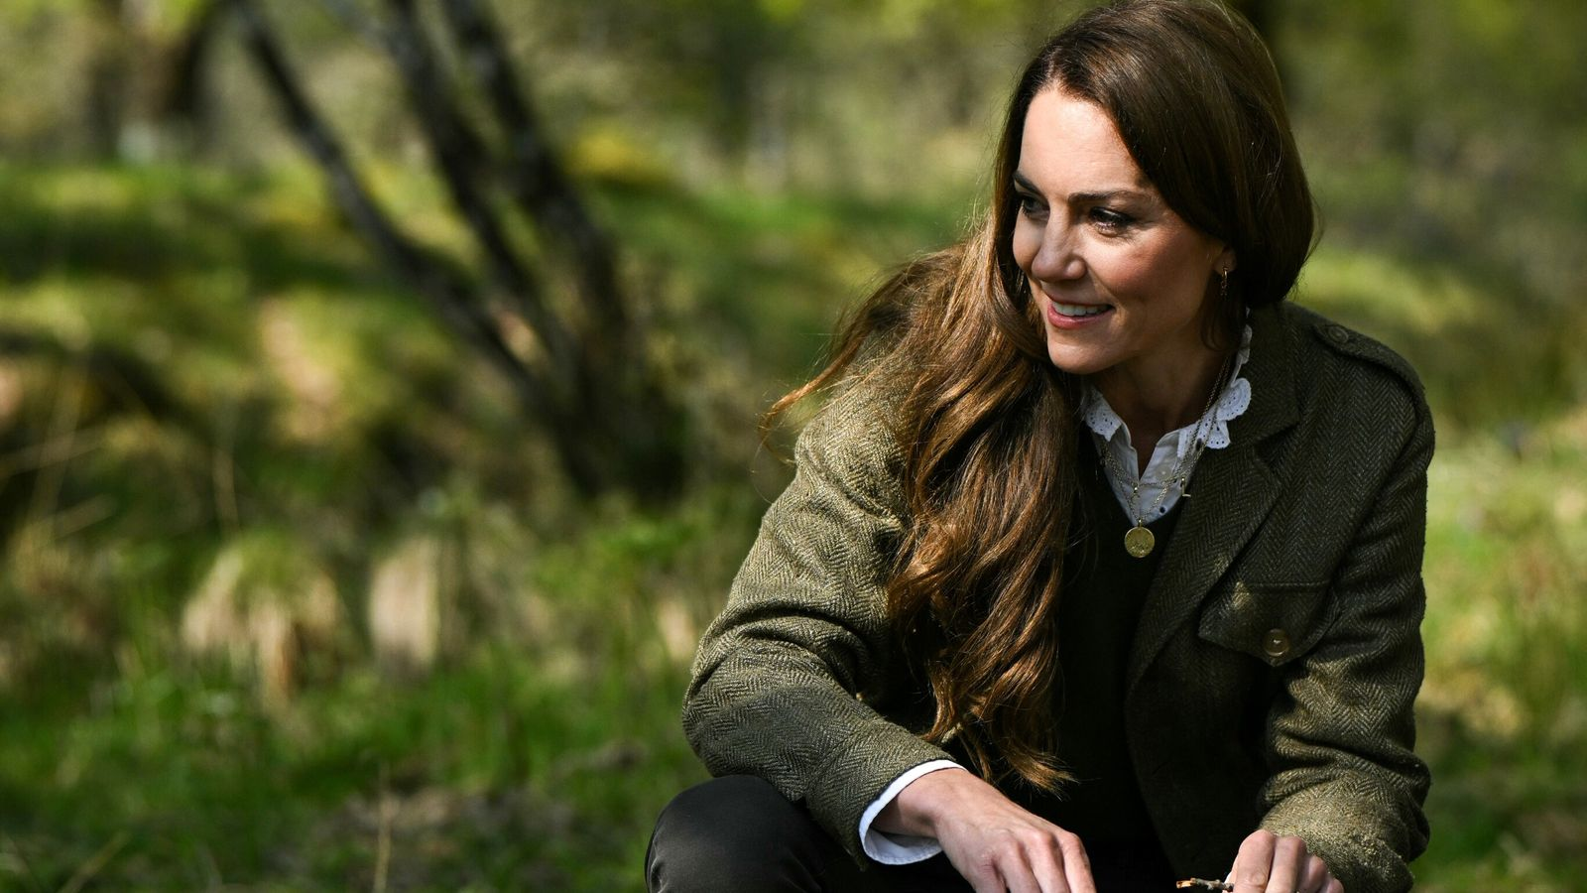

Slide 11


1) WHO IS YOUR PROVIDER IN LIFE

Slide 12



1) WHO IS YOUR PROVIDER IN LIFE
YOURSELF
CHANCE
GOD

Slide 13
  There must be the daily practice of the reality of the God who we know is there
  Francis Schaffter

Slide 14
1) WHO IS YOUR PROVIDER IN LIFE

Slide 16
Seeing your Heavenly Father

Slide 17
2) WHAT IS YOUR PRIORITY IN LIFE

Slide 18
1) WHAT IS YOUR PRIORITY IN LIFE
²⁵ “Therefore I tell you, do not worry about your life, what you will eat or drink; or about your body, what you will wear. Is not life more than food, and the body more than clothes?
²⁶ Look at the birds of the air; they do not sow or reap or store away in barns, and yet your heavenly Father feeds them. Are you not much more valuable than they? ²⁷ Can any one of you by worrying add a single hour to your life? ²⁸ “And why do you worry about clothes? See how the flowers of the field grow. They do not labour or spin. ²⁹ Yet I tell you that not even Solomon in all his splendor was dressed like one of these. ³⁰ If that is how God clothes the grass of the field, which is here today and tomorrow is thrown into the fire, will he not much more clothe you—you of little faith?
³¹ So do not worry, saying, ‘What shall we eat?’ or ‘What shall we drink?’ or ‘What shall we wear?’ ³² For the pagans run after all these things, and your heavenly Father knows that you need them. ³³ But seek first his kingdom and his righteousness, and all these things will be given to you as well. ³⁴ Therefore do not worry about tomorrow, for tomorrow will worry about itself. Each day has enough trouble of its own.

Slide 19
2) WHAT IS YOUR PRIORITY IN LIFE
  But seek first his kingdom and his righteousness, and all these things will be given to you as well
  (v.33)

Slide 21
Seeking His Kingdom
Seeing your Heavenly Father

Slide 22
Herein lies a deep irony of human existence. According to Jesus’ teachings, when people seek to keep everything together and provide for themselves apart from God, the result is not the sough-after peace, but rather, anxiety.
Jonathan Pennington

